Slide 1






March2023| NEWSLETTER ISSUE 05
dTour
"Introducing digitisationfor boosting SMEs in Tourism and Hospitality"
5th Newsletter –March 2023
AGREEMENT NUMBER
The dTour Erasmus+ project, aims at training and certifying dTour advisers in order to promote digitalization in Tourism and Hospitality SMEs, is in progress and this newsletter provides with the latest information on:
The project progress
The last meetings and the Final Conference
The dTour Curriculum and Educational Materials
The Navigation Guide
The next steps of the project
KA202-46D087DB
START DATE
DECEMBER 01, 2020
DURATION
29 months
https://dtour.projectlibrary.eu/en/

Slide 2

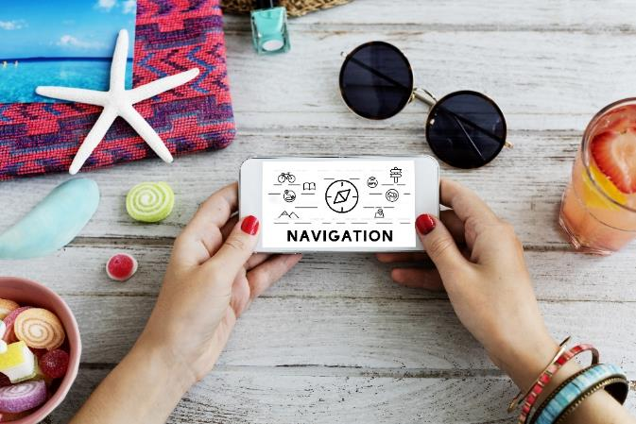
MARCH2023| NEWSLETTER ISSUE 05
Project progress
Approaching the completion of the project, the training of the dTour advisers candidates was successfully conducted and the completion of their exams is expected in order to obtain the "dTour consultant" certification (ISO17024), an output vital for the success of the project. At the same time, the final deliverable of the project, the dTour Navigation Guide (digital book) which will help SMEs related to Tourism and Hospitality to learn about new digital technologies and tools and how they can benefit from using them, has been successfully completed. Finally, the final conference of the project organized by the Chamber of Magnesia was successfully held on the 30th of March 2023 in Volos (Greece).
Navigation GuidedTour
The dTour navigation guide was designed to enable SMEs related to Tourism and Hospitality to get to know the new digital technologies and tools used in the sector to get a first idea of ​​how they can benefit from their use . This navigation guide can give SMEs a first idea of:
Which digital tools and technologies are available and suggest the right digital tools according to the needs of SMEs
Which tools should SMEs use according to their scale
When should SMEs use these tools (eg pre-trip to inform and engage / during the trip to facilitate, engage and offer a better experience / post-trip to gain feedback and attract new customers).
The guide has been developed as an ebook, and is available in Greek, English and Swedish and everyone may download it from the project website https://dtour.projectlibrary.eu , but also as a digital app which is free and available to the public here: https://dtour.projectlibrary.eu/en/dtour-navigation-guide.html

Slide 3

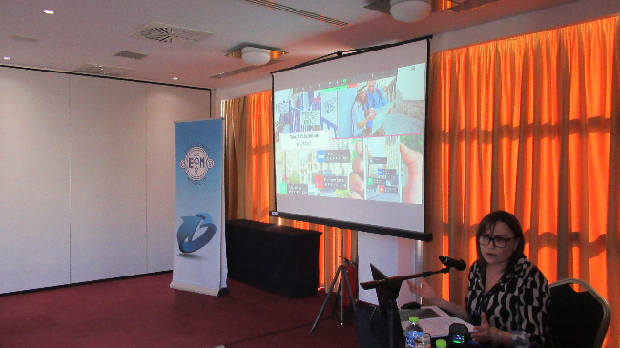
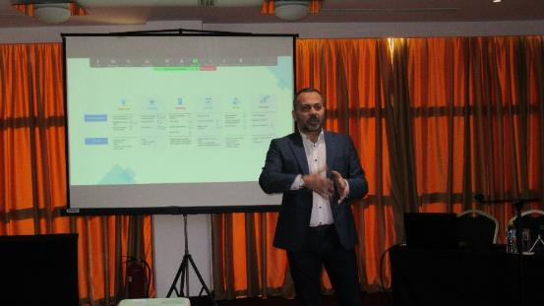
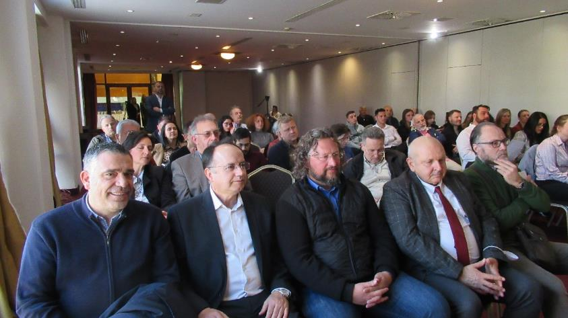
MARCH2023| NEWSLETTER ISSUE 05
The Final Conference of the Project
The presentation of the results of the dTour project which concern the trends in the tourism industry, the digital tools that tourism businesses can use and the presentation of the available financial programs for the digitization of the SMEs, were the central topics of the Conference organized by the Chamber of Magnesia in Volos (Greece).
Representatives of the tourism sector from Magnesia’s mainland, including Pelion, but also of North Sporades had the opportunity to hear from the Coordinator partner of the dTour project, as well as from experts on the field about proposed solutions and tools for the digital transition of tourism businesses.
In this context, all the current trends in the tourism sector were analyzed, the digital tools that tourist companies can use and the available financial programs for the digitization of businesses were introduced to the participants.

Slide 4

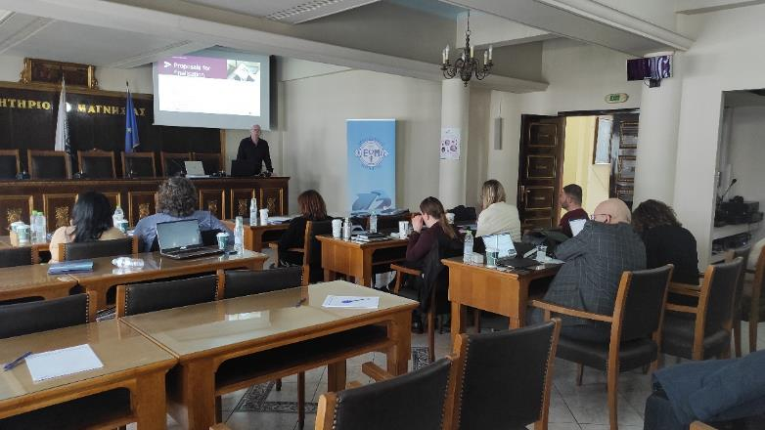

MARCH2023| NEWSLETTER ISSUE 05
Final meeting of the project partners
The next day after the Conference, the final transnational meeting of the partners took place, where, among other things, were discussed the progress of the project, the remaining steps and the expectations for the utilization of the project's results.
The common conclusion of the partners was that the existence of an dTour Consultants can play a particularly important role in the digital transformation of small and medium-sized tourism businesses that do not have the resources, the infrastructure and the know-how that larger tourism units can afford to have.
So the existence of a dTour advisers can offer them the possibility to assist them in their digitization procedure by suggesting smart and economical digital solutions that will give added value to their business. Unfortunately, going digital is the only way to strengthen their competitive position and their survival in a highly competitive and constantly changing environment, such as that of Tourism.
What follows;
We continue to work together on the project. If you need more information or decide to train yourself and be certified as dTour Advicer you can contact the project partners who can be found at our website https://dtour.projectlibrary.eu/en/and on dTour Facebook profile page @dTourEU.

Slide 5










MARCH 2023| NEWSLETTER ISSUE 05
THE PARTNERSHIP
The project brings together 7 partners from 5 European countries, forming a transnational cooperation partnership with a balanced regional geographical representation of the Erasmus+ area and with a qualitative representation of countries highly dependent on the tourism industry
COORDINATOR:
DIMITRA EDUCATIONAL ORGANIZATION (GREECE)
COLLABORATORS:
MMC MANAGEMENT CENTER (CYPRUS)
LARNACA TOURIST BOARDS(CYPRUS)
ACTA (GREECE)
CHAMBER OF MAGNISSIA (GREECE)
RINOVA LTD (UK)
FOLKUNIVERSITETET (SWEDEN)
Introduction of digitization to strengthen SMEs in Tourism and Hospitality

